Slide 1


Project number: 2023-1-CZ01-KA121-VET-000135958
Cindy Anna Renk
M3.A
63-41-M/01 Economy and Business
Thessaloniki, Greece 2024

Slide 2
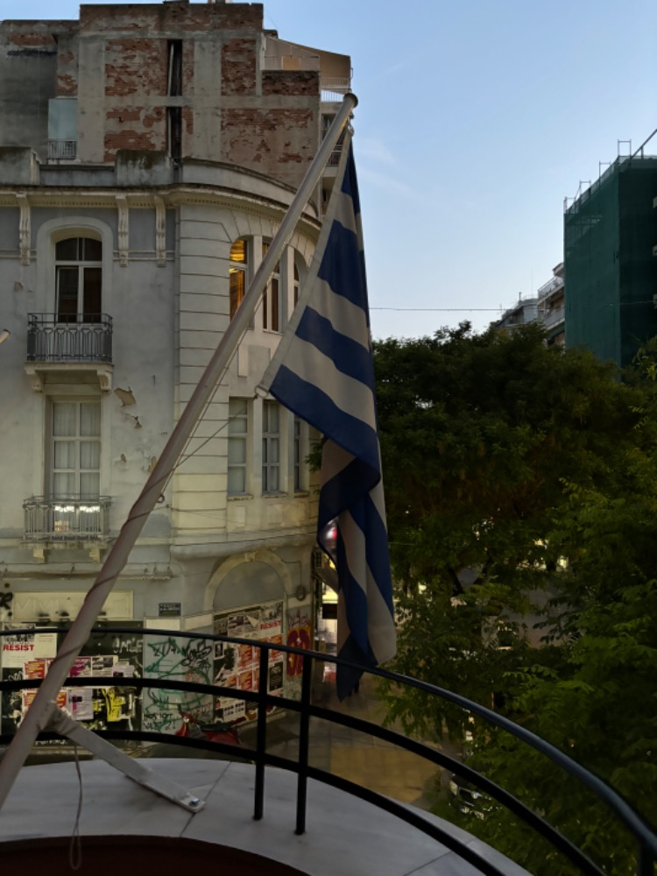
Content of the presentation
place and duration of stay
company
organizational structure of the company
description of performed activities
leisure activities
benefit - acquired skills

Slide 3
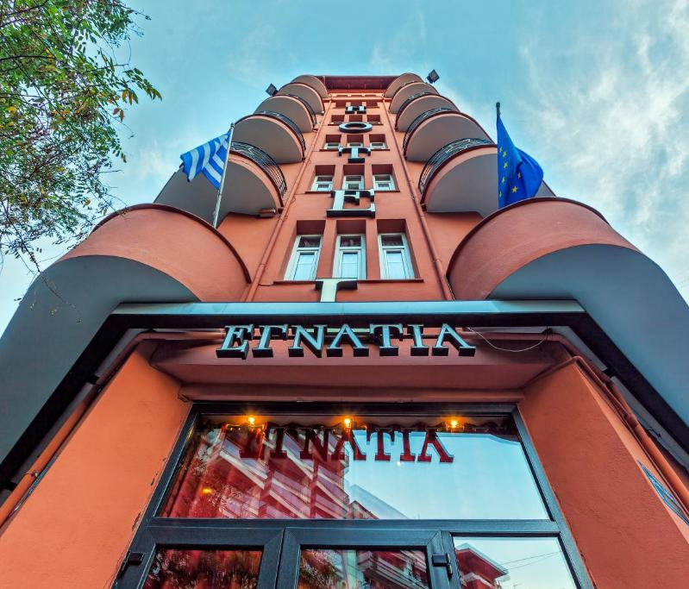
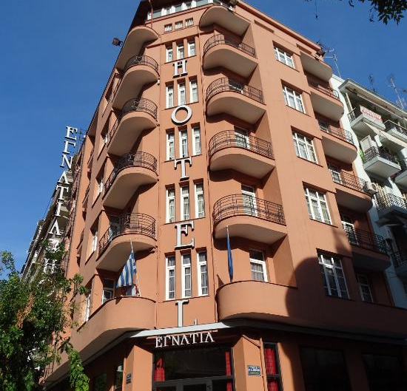
Our place of stay
We arrived on 19th May and stayed in Hotel Egnatia for 3 weeks.
In each room were living 3 students.
The hotel was located in Thessaloniki near the Egnatia street.
The place was gorgeous and most of the stores were near the hotel.

Slide 4
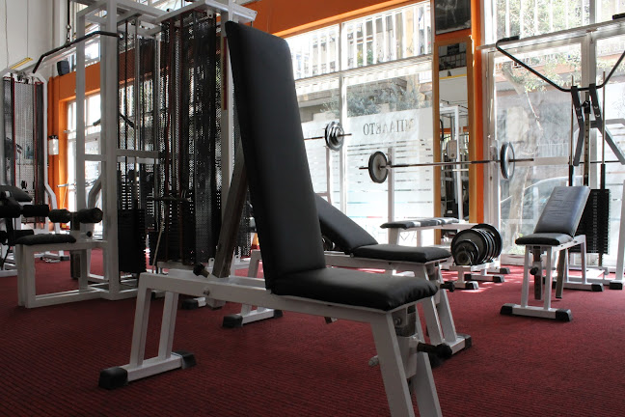
Gym Athlisis
Gym Athilis is a beautiful preserved fitness center where people can go to exercise every day with an assistant trainer.
It has one room for pilates and another room for lifting.

Slide 5
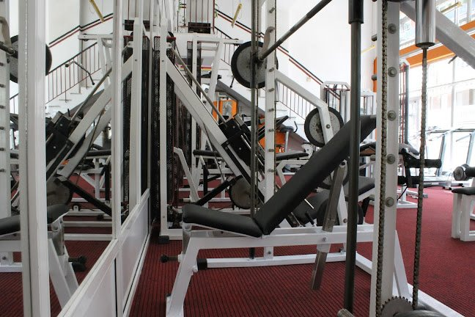
Organizational structure of company
Gym owner
Trainers
Maintainers
Cleaners

Slide 6
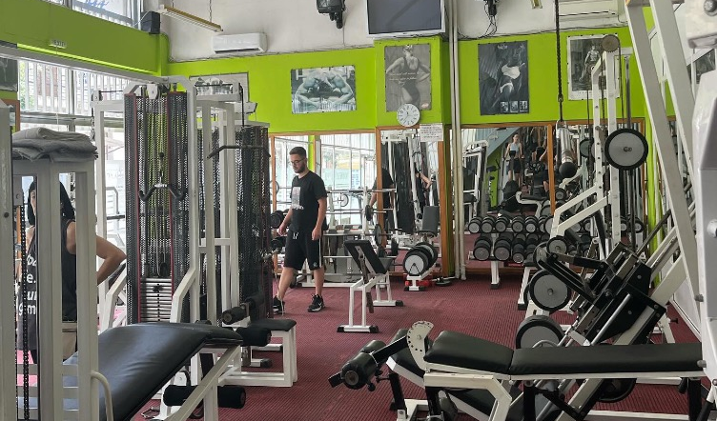
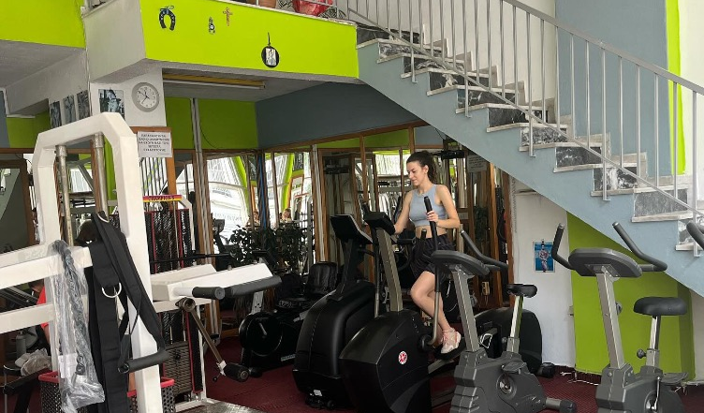
Performed activities
We worked in the gym for 13 days from 9 to 13 o'clock.
He showed us the papers and licenses that people must have to own a gym or to apply for entry.
We learned about: nutrition, how to maintain a gym, how to exercise the muscles in the whole body and how to avoid injuries.

Slide 7
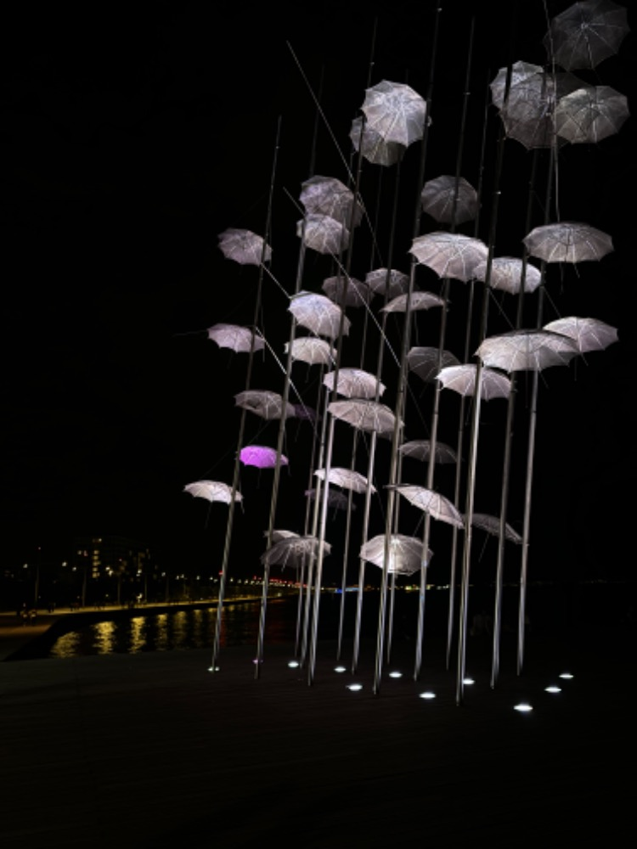
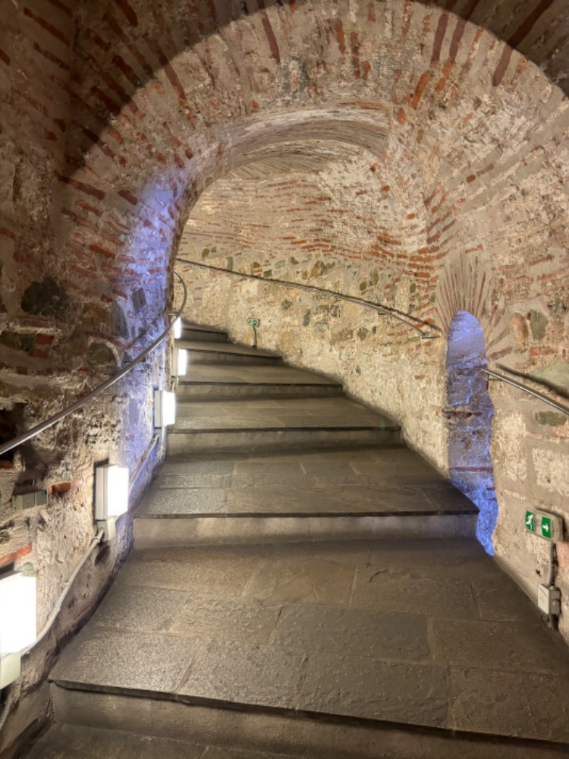
Leisure activities
In our free time we went to see different monuments and we enjoyed it very much.
The guide always told us the history of the monuments and explained everything to us so we even learned a lot about the culture.

Slide 8
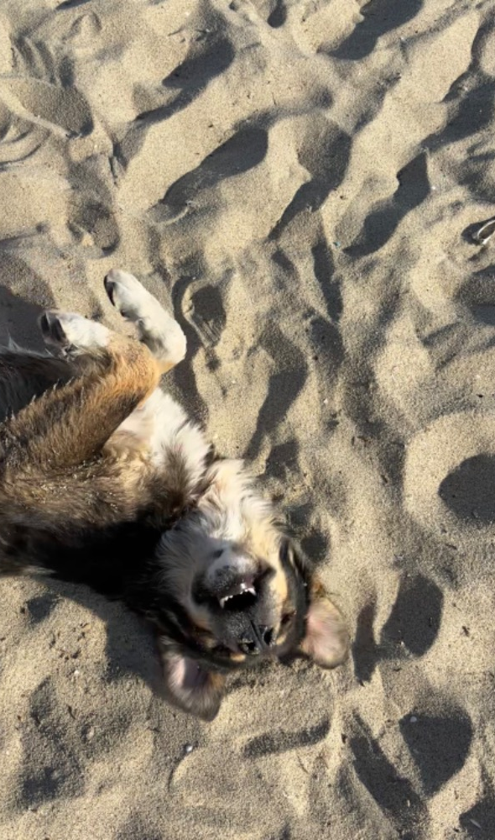
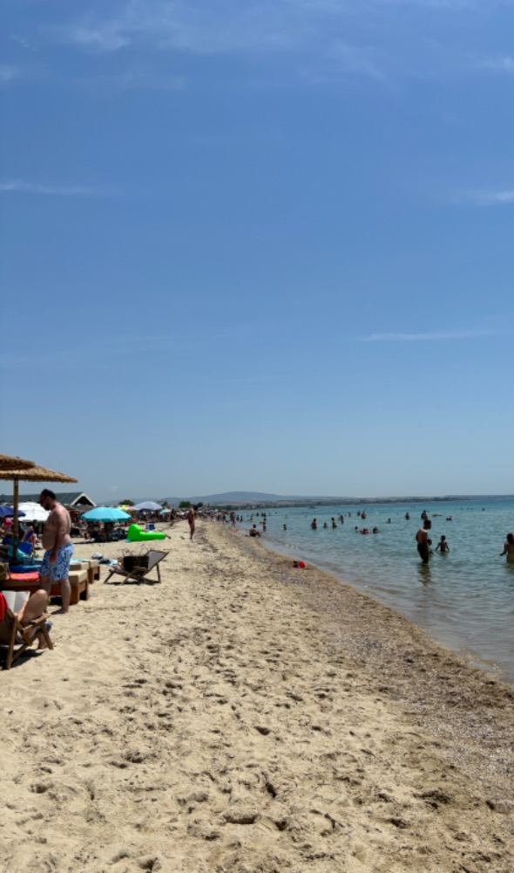
Perea Beach

Slide 9
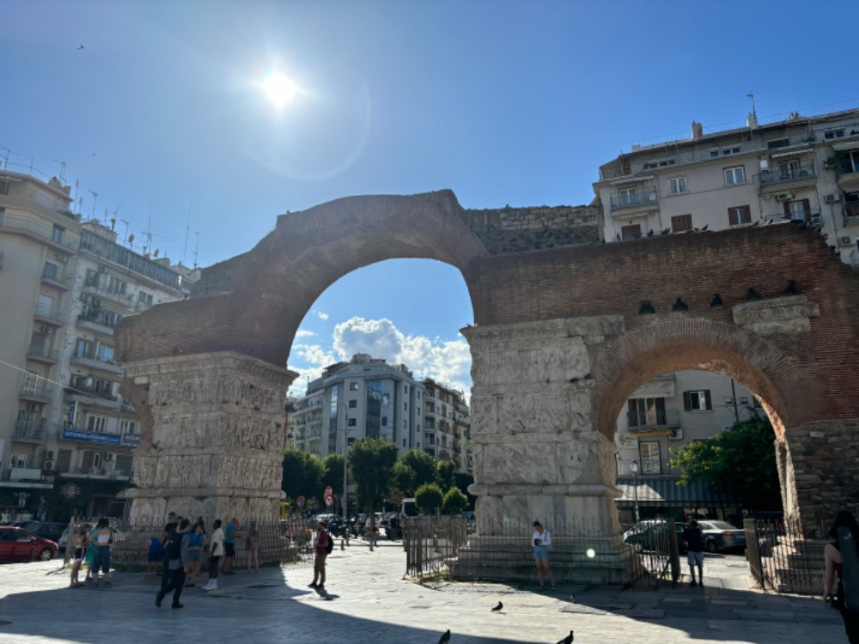
Arch of Galerius

Slide 10
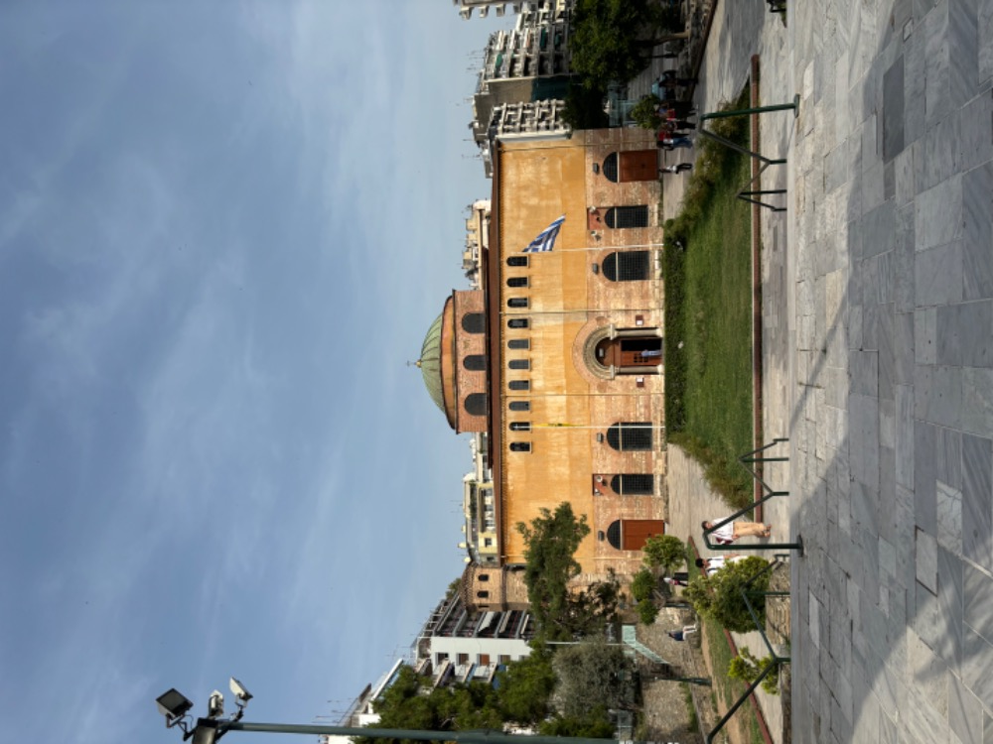
Saint Sophia

Slide 11
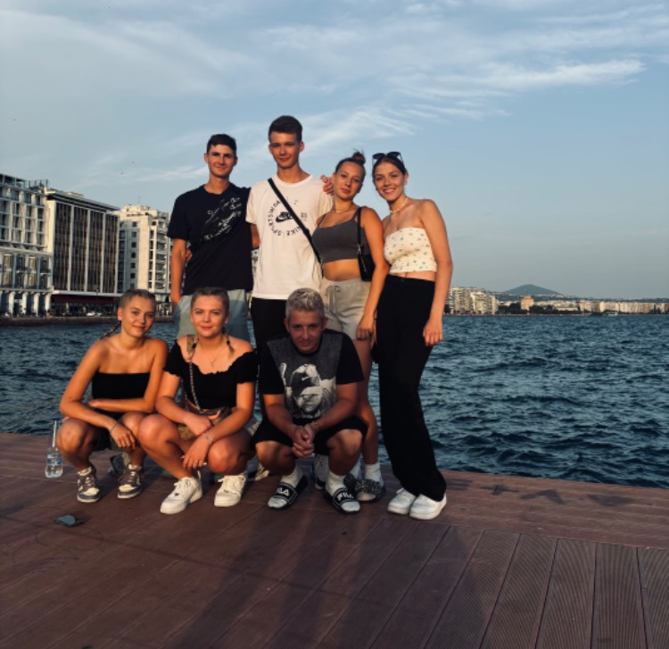
Acquired skills
I've improved my English skills.
I learned new things about Greek culture and monuments.
I earned experience with sports management.
I've improved my communication and adaptation.

Slide 12
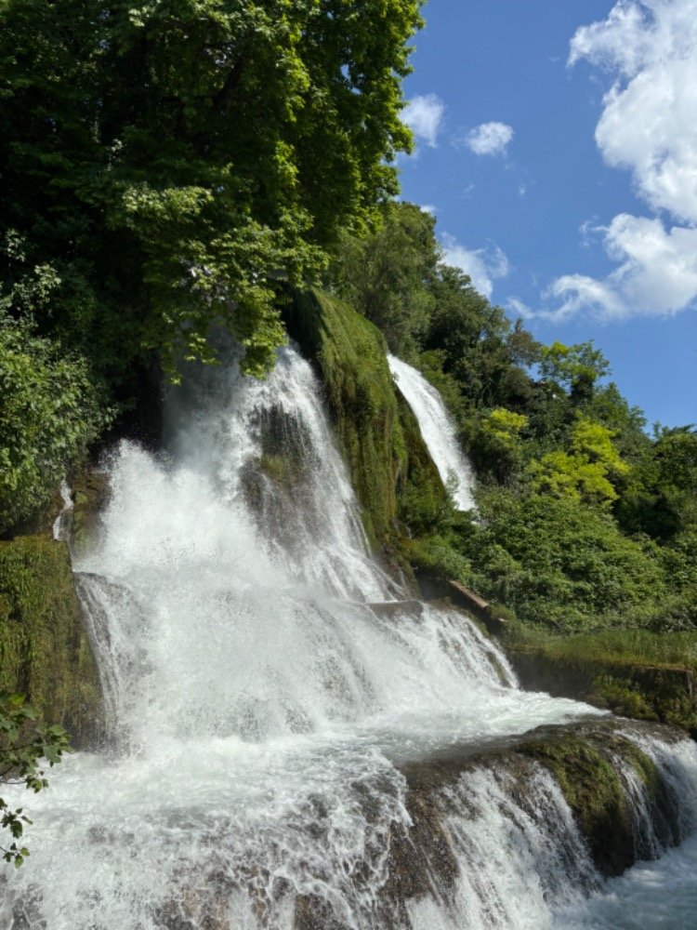
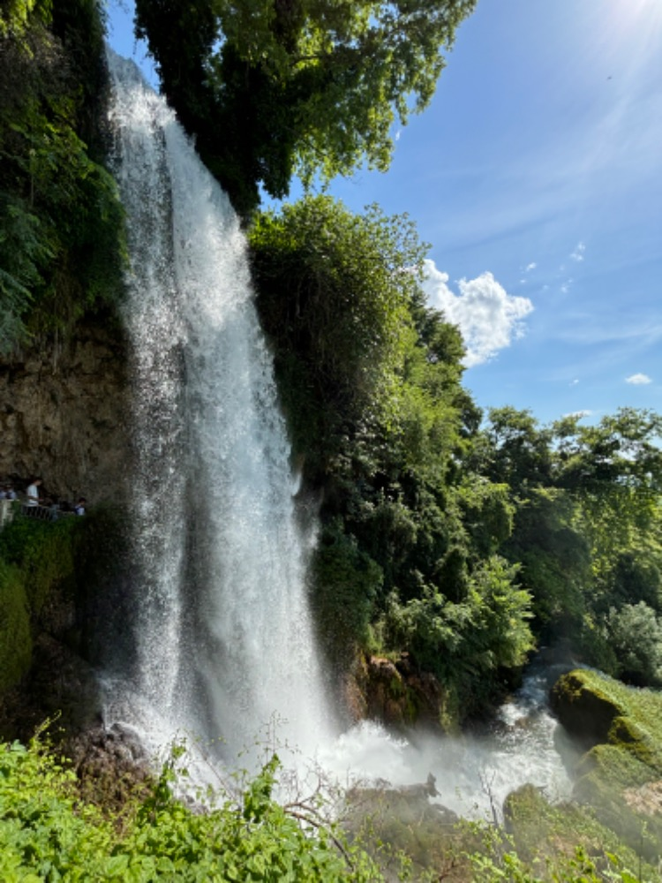
Thank you for your attention

Slide 13
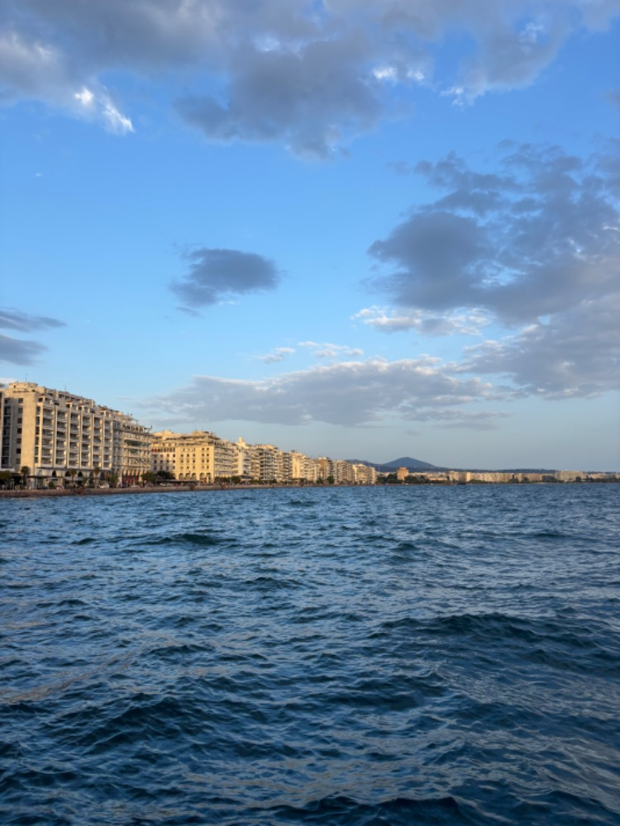
Resources
https://www.booking.com/hotel/gr/egnatia-perea.cs.html
https://www.tripadvisor.de/LocationPhotoDirectLink-g189473-d233056-i153912329-Egnatia_Hotel-
https://citymaps.gr/gumnasterio/thessalonike/gym-athlisis/
https://citymaps.gr/gumnasterio/thessalonike/gym-athlisis/

